Slide 1
Tweet Sentiment Analysis and Candidate Prediction
Saniddhya Dubey, Ruchitha Kudumula, Kevin Avila, Micheal Rawlings, Namasani Deepak

Slide 2
Introduction
The 2020 election showed Twitter’s impact on political discourse and public opinion.
We analyze tweets to capture election dynamics and sentiment.
Social media analysis reveals voter attitudes and behaviors.
This helps predict trends and shape future campaign strategies.

Slide 3
Summary of Goals
Clean an unbiased, utilizable dataset
Find the sentiment of tweets for each candidate
Predict the winning candidate using 2020 election related tweets sentiment
Visualize our results and show trends in election

Slide 4
Approach (Preprocessing)
Preprocess the data
Removed URLs in tweets
Removed mentions (usernames) in tweets
Normalized excessive punctuation in tweets
Removed extra spaces
Dropped duplicate values, rows with missing values, and user_name column for both dataframes
Converted all tweets to lowercase and tokenize
Lemmatize tokens and remove stop words

Slide 5
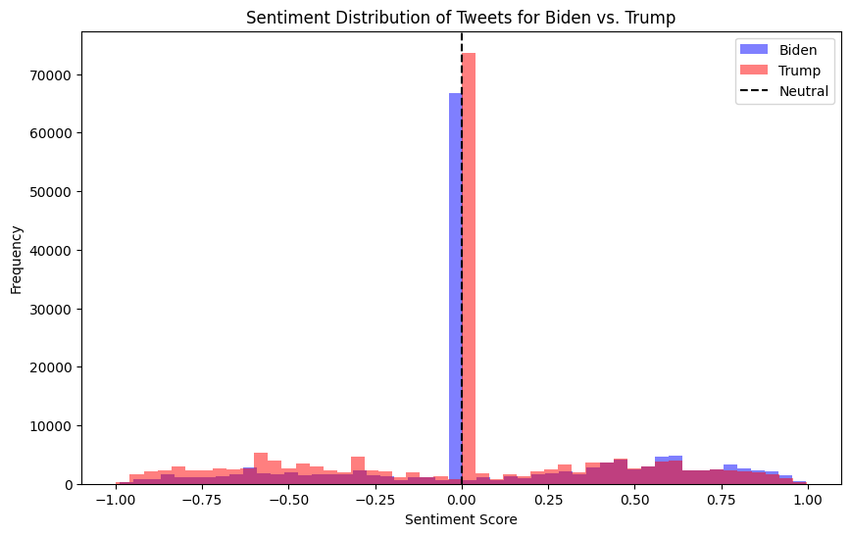
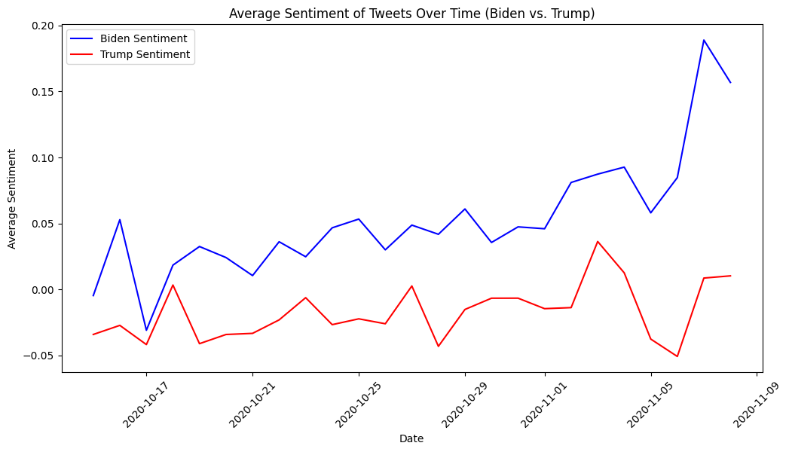
Approach & Results (Vader Sentiment Analysis)
Apply nltk’s SentimentIntensityAnalyzer
Allows us to get the sentiment of the tweets column by using the polarity_scores method from SentimentIntensityAnalyzer
Using the sentiment column we get from SentimentIntensityAnalyzer we can also see the sentiment change over time

Slide 6
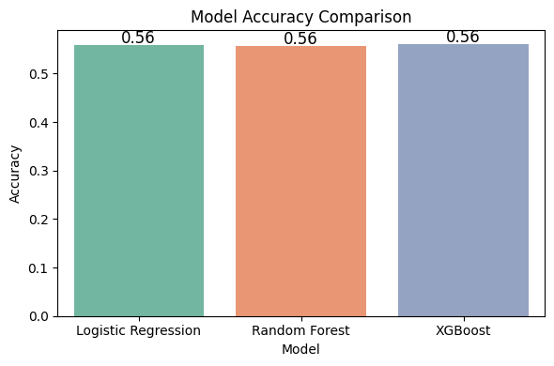
Approach & Results (Model Training)
Using the sentiment column created, we combined it with a target column of 1 for Biden and 0 for Trump. To get the prediction on the winning candidate we applied the three following models:
Logistic Regression
Random Forest
XGBoost

Slide 7
Conclusion
In conclusion, we show that the sentiment towards Biden was higher with an average sentiment of 0.09 and -0.01 with Trump. We also show how the sentiment never dipped below Trump’s sentiment over time.
We show that each model predicted that there was a 56% chance of Biden winning the presidential election in 2020 based off sentiment analysis from tweets.
This signifies that there is a correlation between the sentiment of tweets and who will win the presidential election. Something key we saw was that Biden won the popular vote by about 4% in 2020 and our model was predicting a close race with a 56% chance of Biden winning .

Slide 8
THANK YOU

